Slide 1
Leadership Training
TC
11

Slide 2

Agenda
Basic Finance
Consumer Protections
Planning for the Future
Compensation, Benefits, and Entitlements
Leadership Training Member Checklist Available

Slide 3

Basic Finance
Leadership Training Member Checklist Available

Slide 4
The Need for Personal Financial Management
Financial readiness is mission readiness
Don’t wait
  Personal challenges
  Professional challenges
Where to turn
  Command Financial Specialists (CFSs)
  Personal Financial Managers (PFMs)
  Coast Guard Mutual Assistance (CGMA)
  CG SUPRT Money Coach
The Need for Personal Financial Management Handout Available

Slide 5
Common Financial Warning Signs
Unable to pay bills
Unable to afford car
Insufficient funds charges
Not enough money
No savings
No emergency fund
Overwhelmed with debt
Spouse lost job
Divorce / separation
Can’t sell their home
Facing foreclosure or repossession
Financial Warning Signs Handout Available

Slide 6
Potential Consequences
Military
Financial
Negative evaluation
Loss of promotion
Loss of overseas transfer
Loss of security clearance
Reduction in rank
Non-judicial punishment (NJP)
Admin discharge
Overdraft fees
Denied credit
Bad credit report
Low credit score
Repossession
Foreclosure
Bankruptcy
Financial Warning Signs Handout Available

Slide 7
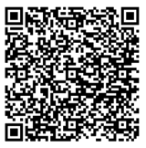

Leaders and Economic Security
Three areas of focus:
Financial well-being
Housing availability
Food security
Base resources:
CFS and PFM personnel, Health, Safety and Work-Life (HSWL) Regional Practice, housing office
Online resources:
Coast Guard –
Economic Security Toolkit
FINRED – Financial Well-Being Assessment

Slide 8
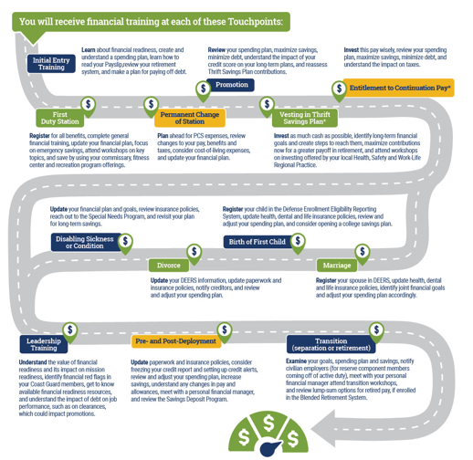
Touchpoint Training Requirements
13 Career Touchpoints
MANDATORY
since 2016
Proactive leadership
required

Slide 9
Understanding Credit
Review credit report
  https://www.annualcreditreport.com
  Take advantage of free credit monitoring
Understanding credit
  Credit reports
  Credit scores
Create healthy habits
  Spending plan
  Pay on time
  Pay off credit cards monthly
  Only apply if you need credit
  Safeguard information
  Reconcile statements
Types of
Credit
10%
New
Credit
10%
Length of
Credit History
15%
Payment
History
35%
Amounts
Owed
30%
Understanding Credit Handout Available

Slide 10
Consumer Protections
Leadership Training Member Checklist Available

Slide 11
Military Consumer Protection Laws
Servicemembers Civil Relief Act (SCRA)
  6% APR for Pre-Active Duty debt
  Student loans
  Leases
  Legal proceedings
  Default judgments
Military Lending Act (MLA)
  36% interest cap
  Covers most consumer loans
Military Consumer Protection and SCRA Handouts Available

Slide 12
Sources of Help for Military Consumers
Consumer complaints
  Contact the business
  Contact the company president
  Contact local and state consumer advocates
Key takeaways
  Protect your personal information
  Protect your credit
  Practice online safety
Sources of Help for Military Consumers Handout Available

Slide 13
Planning for the Future
Leadership Training Member Checklist Available

Slide 14

Retirement
Understand the benefits of the military retirement systems
Understand the importance of retirement planning
Understand and review TSP options
Start planning now!
Military Retirement Handout Available

Slide 15
Military Retirement Overview
 | Legacy (High-3) | Blended Retirement System (BRS)
Pay Formula | Years & months of service x 2.5% x average of 36 highest months of base pay | Years & months of service x 2% x average of 36 highest months of base pay
COLA | Full | Full
20 YOS | 50% | 40%
30 YOS | 75% | 60%
40 YOS | 100% | 80%
TSP | Yes, but without government contributions | Yes, with government contributions
Continuation Pay | No | Yes, between 8-12 YOS with service obligation
Lump-Sum Option at Retirement | No | Yes (25% or 50% with reduced annuity until age 67)
Military Retirement Handout Available

Slide 16
BRS Thrift Savings Plan
Contributions
Defined Contribution Thrift Savings Plan (TSP)
You Contribute (Roth and/or Traditional) | Coast Guard Automatic Contribution (Traditional) | Coast Guard Matching Contribution (Traditional) | Total Contribution
0% | 1% | 0% | 1%
1% | 1% | 1% | 3%
2% | 1% | 2% | 5%
3% | 1% | 3% | 7%
4% | 1% | 3.5% | 8.5%
5% | 1% | 4% | 10%
More Than 5% | 1% | 4% | Your Contribution + 5%
Service members who joined on or after January 1, 2018:
• 1% Coast Guard Automatic Contribution begins 60 days after entering service.
• 4% Coast Guard Matching Contributions begin after completing 2 years of service.
• Both automatic and matching contributions are vested after serving two years.
Military Retirement Handout Available

Slide 17
Understand…
The importance of retirement planning
  Never too early (or late) to start
  The sooner you start the less you may have to save
  Gives more time to accumulate wealth
  Review periodically
TSP and withdrawal options
  Review fund options annually
  Leave in TSP
  Transfer into an IRA or employer retirement plan
  Withdrawing early has penalties and could have
  tax implications
  Withdrawal when eligible
  at age 59½ without penalty
Thrift Savings Plan Handout Available

Slide 18
Compensation, Benefits,
and Entitlements
Leadership Training Member Checklist Available

Slide 19
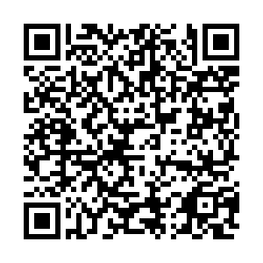
Career Investment Programs
United States Military Apprenticeship Program (USMAP)
Credentialing Opportunities On-Line Program (COOL)
Military Tuition Assistance Program
Leadership Training Member Checklist Available

Slide 20
Summary and Resources
Leadership Training Member Checklist Available

Slide 21
Summary
Congratulations on reaching this important milestone!
You are taking on a leadership role in the Coast Guard and the responsibility for ensuring individual financial readiness to sustain mission readiness for your command.
We briefly discussed:
  Basic Finance
  Consumer Protections
  Planning for the Future
  Compensation, Benefits, and Entitlements

Slide 22
Resources
Checklist and Handouts
Financial Education and Support
  Command Financial Specialists (CFSs)
  Personal Financial Managers (PFMs)
  Health, Safety and Work-Life (HSWL) Regional Practice
  Coast Guard Mutual Assistance (CGMA)
  CG SUPRT Money Coach
Financial Literacy Mobile Apps
  Coast Guard Work-Life mobile app
  DoD FINRED Sen$e mobile app

Slide 23
Thank You!
The appearance of U.S. Department of Homeland Security (DHS)
visual information does not imply or constitute DHS endorsement.

